Slide 1
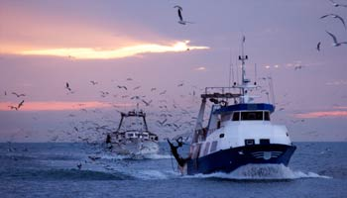
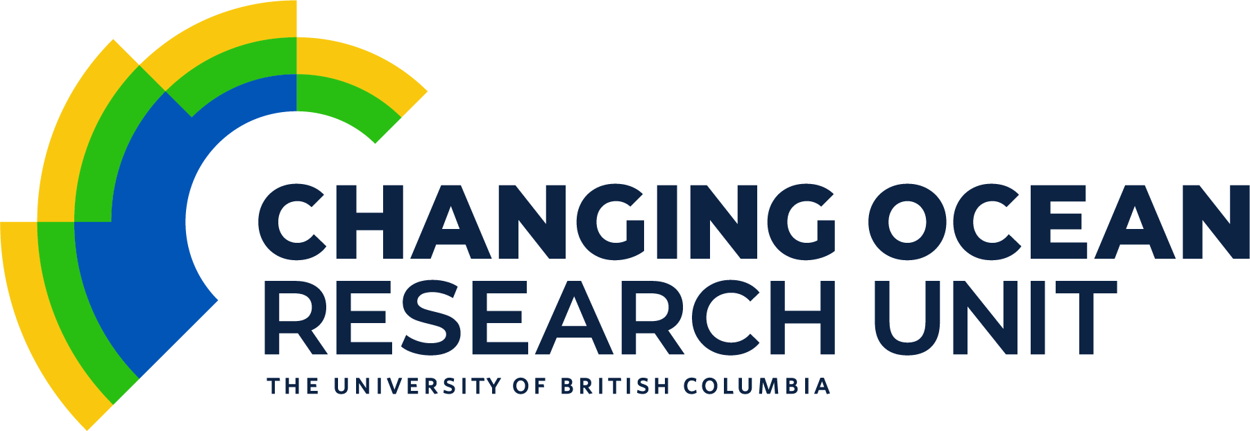
Transboundary resources management under climate change in Canada
Colette Wabnitz | Juliano Palacios-Abrantes
University of British Columbia
International dimensions | Team meeting Ottawa | 10-11 January 2019

Slide 2
Importance of Canada’s marine resources
Commercial marine fishing vessels landed 848,165 8.4k tonnes valued at CAD3.3 billion.
Over 78% (89% by value) of total catch was landed in the Atlantic.
Shellfish accounted for 48% of total catch, pelagics 26% and groundfish 24%.
Fishing sector provides opportunities to 76,400 76 K Canadians.
Transboundary fisheries in B.C. alone, for 2016, accounted for CA$ 161.6 million | hake (CA$70.5), salmon (chinook, CA$47.5) and pacific halibut (CA$43.6)
Cultural importance particularly for Indigenous communities
DFO (2016) | BC Government (2017)

Slide 3
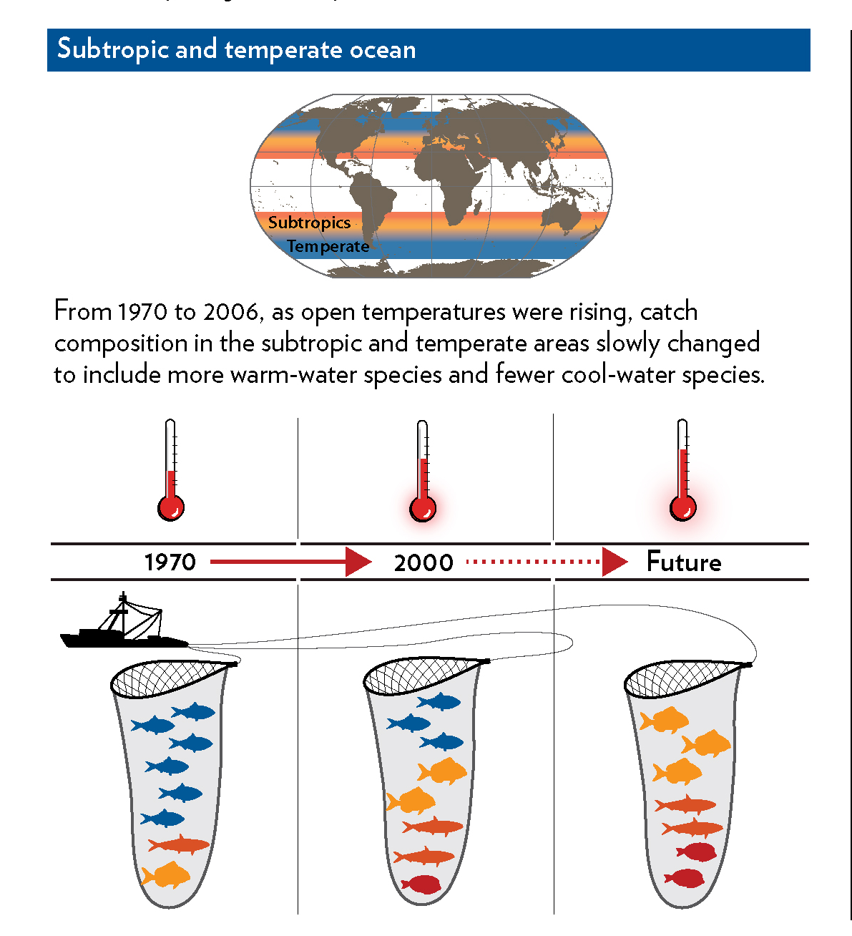
Climate change impacts
Changes in temperature
Changes in pH
Changes in oxygen
Thus far temperature appears to have been main driver
Temperature will continue to play key role in the context of transboundary stocks
Oxygen playing an increasing role – harder to predict
Cheung et al. (2013)
Notes:
But climate change through the redistribution of species and dramatic alterations in community structure is having and will continue to have important implications for fishing communities, the economy and seafood consumers
Make note that these changes are in addition to existing pressures on stock through fishing activities, pollution, coastal development etc.

Slide 4
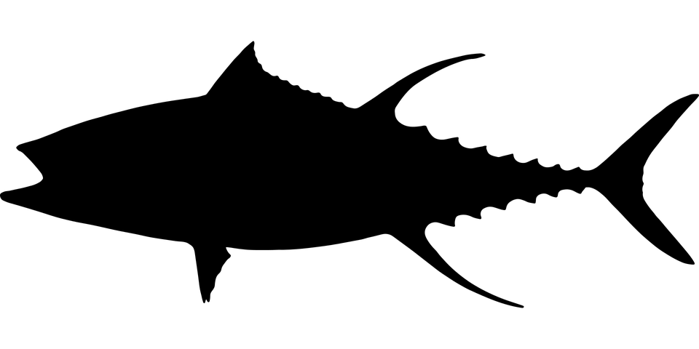
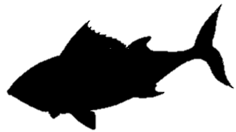
Stock types
High Seas
Country A
Straddling stocks
Country B
Transboundary stocks
Howard et al. (2013)

Slide 5
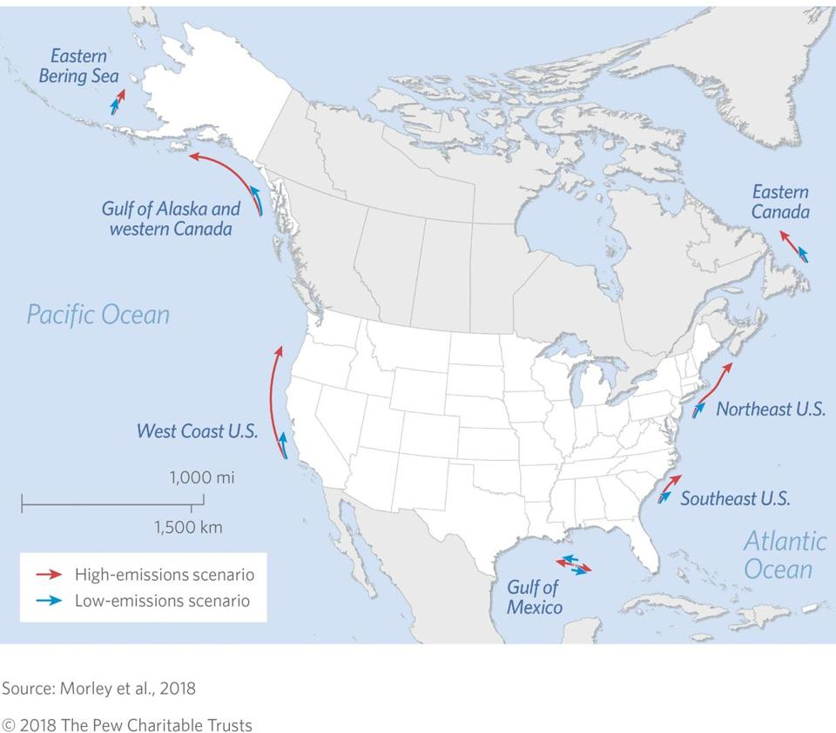
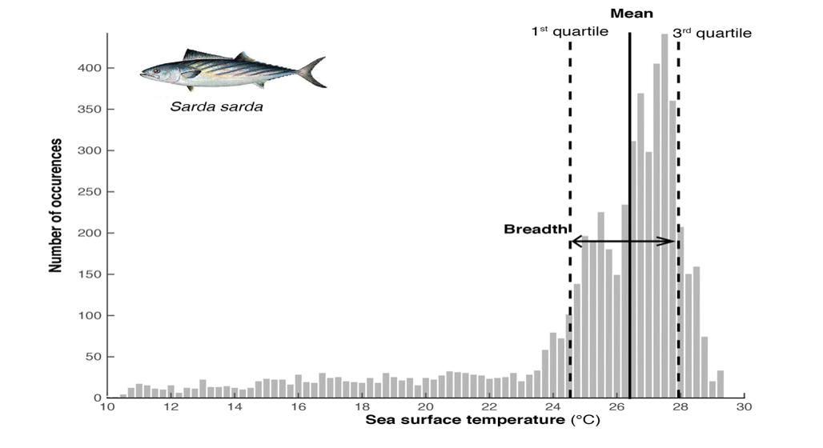
Distribution shift = species’ preferred climate
Notes:
Using models – overall – species in N America are projected to be shifting their distribution poleward so as to stay within their preferred temperature envelope

Slide 6
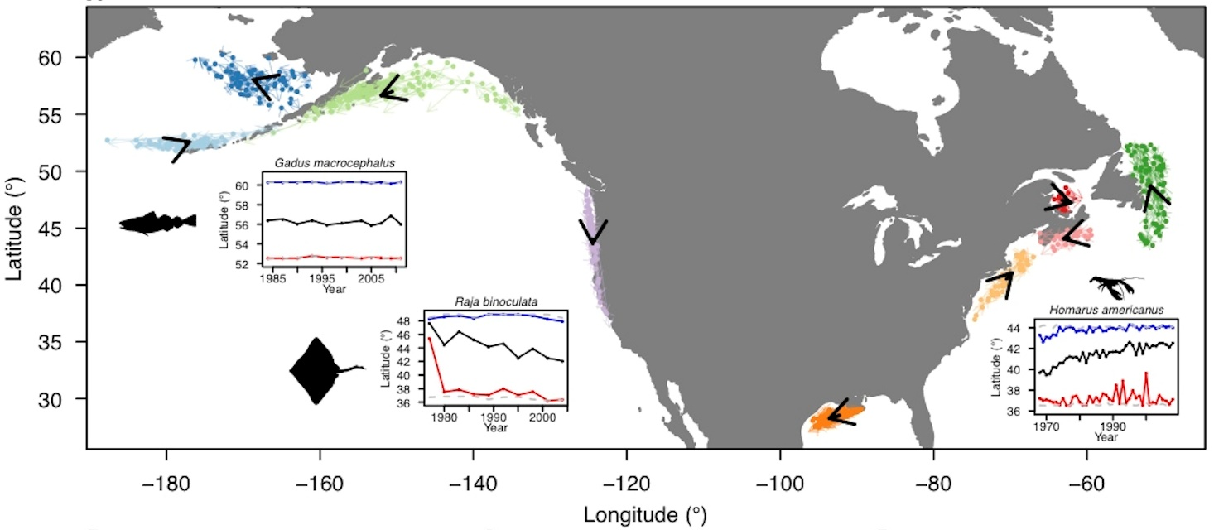
Variation in direction and rate of observed shifts
Climate velocity can explain observed species shifts
Local mosaic of climate velocities is complex
Fundamental reorganization of marine communities
Pinsky et al. (2013)
Notes:
Some observed species shifts appear to buck the overall trend of a poleward shift
Climate velocity – rate and direction that climate shifts across the landscape.
Regional factors such as wind and associated currents or seafloor topography can actually create local ‘microclimates’, resulting in species bucking the overall projected trend of species migrating poleward.
Data: 1968-2011 – bottom trawls

Slide 7
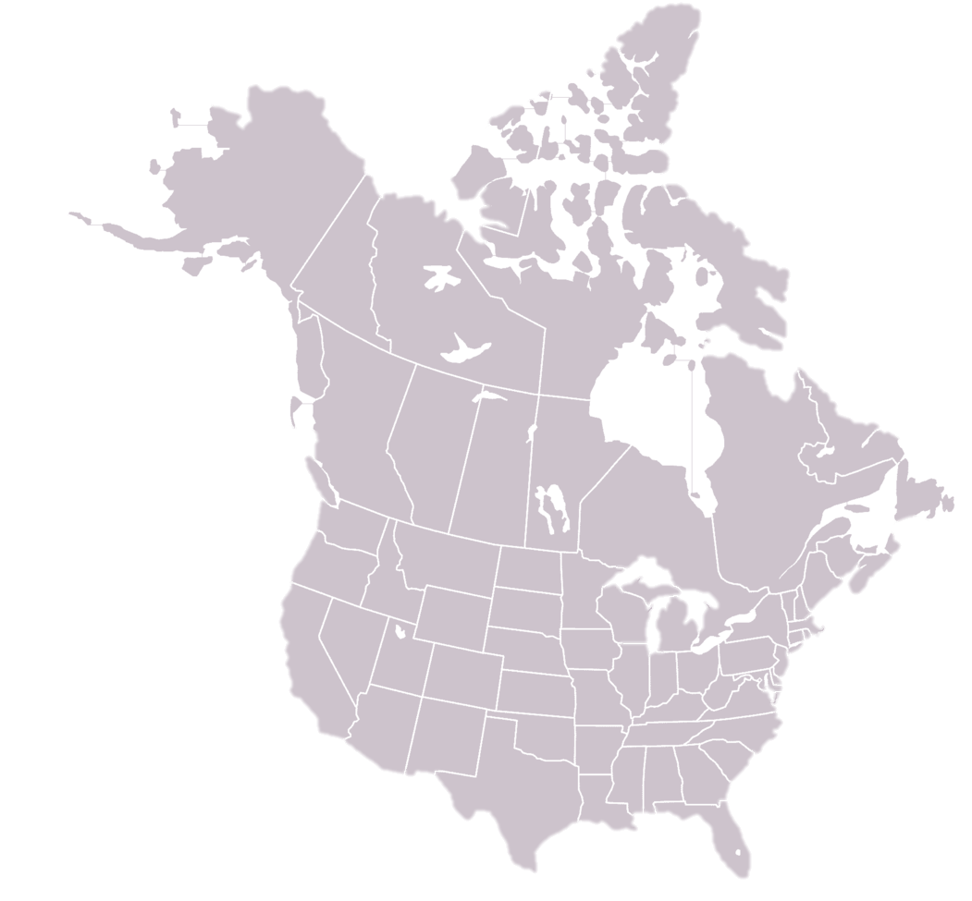
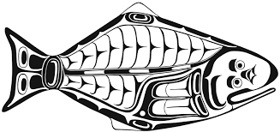
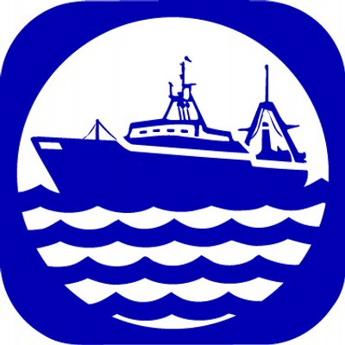
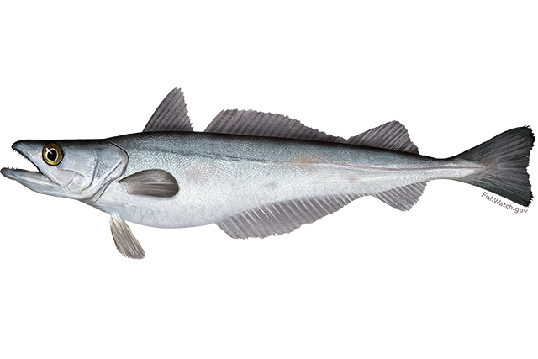
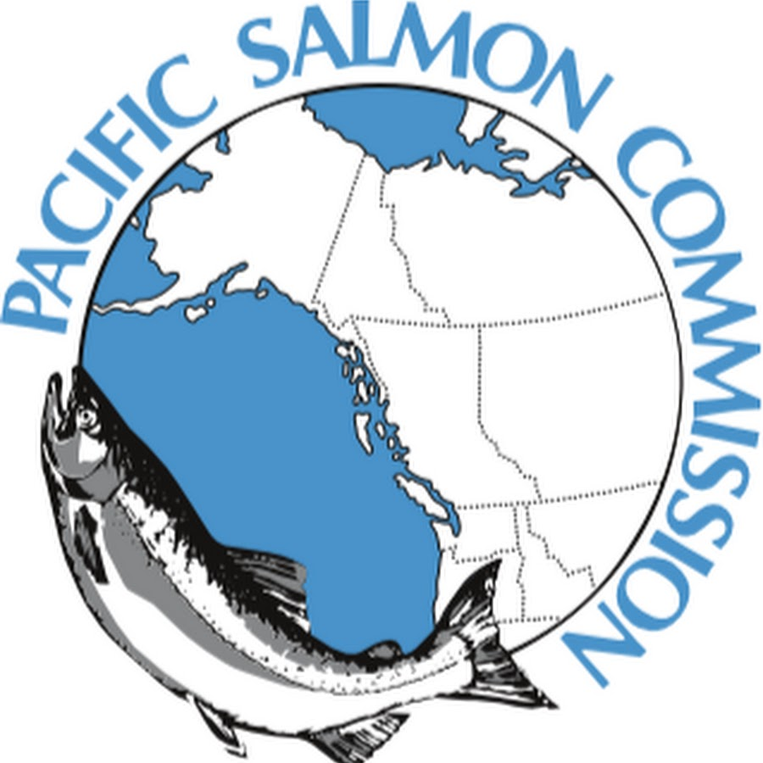


Agreements
International Pacific Halibut Commission
Northwest Atlantic Fisheries Organisation Organization
Pacific hake (whiting) Treaty
Northwest Atlantic Salmon Conservation Organisation Organization
North Pacific Anadromous Fish Commission
Notes:
While a number of studies have looked at empirically understanding species shifts at global levels – or at national levels (e.g., lots of research in the US), a very limited number of studies exist looking at socio-ecological changes, particularly for transboundary stocks.
While fisheries within a given nation may be constrained by regulatory mechanisms, typically they are still able to ‘chase’ after shifting species.
In the case of transboundary stocks fishers cannot move across boundaries.
Transboundary stocks are in essence ‘managed’ by international treaties

Slide 8
Governance challenges under climate change
Treaties mostly assume marine stocks remain static through time
Shifting, expanding, contracting stocks
Emerging fisheries
Fisheries ‘extinctions’
Emerging fishing nations
Management objectives
Critical to understand and anticipate impacts of climate change on stocks to reduce conflict (e.g., mackerel, salmon) and supports planning for adaptation
Notes:
Treaties tend to operate assuming stocks remain static through time and with resource access rights distributed according to historical participation
Increased probability of conflict over the distribution of resource access and benefits
The movement of mackerel into the far North Atlantic has resulted in diplomatic confrontations between Iceland, Norway and Denmark dubbed the "mackerel wars.“
Shifts in species distributions can create incentives for overharvest. For example, a country that is losing a fishery due to climate change may overfish the target species to compensate for the anticipated loss. International agreements can be developed or revised to prevent this from occurring, including through the trading of fishing quota across borders.

Slide 9
Adaptation mechanisms
Incorporate provisions for climate change into management framework
Develop policy narratives
Incorporate provisions for climate change into management framework
Share knowledge and cooperate around available science
Transdisciplinary lens
Capacity to navigate uncertainty
Dubik et al. (2019) | Pinsky & Mantua (2014) | Pinsky et al. (2018)
Notes:
Policy narratives simplify issues by suggesting outcomes and discussing alternative narratives – they support decision making in conflictual settings when issues are complex and outcomes uncertain

Slide 10
Adaptation mechanisms
Side payments
Regional stock assessments
Flexible quota allocation
Tradable permits and/or quota across boundaries
** Equity (can come into conflict with historical access)
** Consider all stakeholders (fishers, processors, etc…)
** Indigenous rights

Slide 11
Research gaps Maybe call it “uncertainty?”
Role of acidification and deoxygenation in observed patterns
Role of other factors, including species interactions, fishing, and species’ ability to disperse and adapt
Climate velocity forecasts
Angert et al. (2011) | Chevin et al. (2010)
Notes:
Ultimately however some of the immediate governance concerns remain the same and steps needed now are the same regardless of the cause

Slide 13
Treaties to manage transboundary stocks
Treaty | Acronym | Ocean | Members | # Members | Species | # Species / species groups
International Pacific Halibut Commission | IPHC | Pacific | Canada and the United States | 2 | Pacific halibut, sablefish | 2
Pacific Salmon Commission | PSC | Pacific | Canada and the United States | 2 | Pacific salmon: chum, chinook, coho, pink, and sokeye | 5
Whiting treaty | WT | Pacific | Canada and the United States | 2 | Pacific hake | 1
Northwest Atlantic Fisheries Organization | NAFO | Atlantic | Iceland, Japan, the Republic of Korea, Norway, the Russian Federation, Ukraine, Canada, Cuba, Denmark (Faroe Islands and Greenland), the European Union, France (Saint Pierre et Miquelon), the United States | 12 | Atlantic cod, redfish, American plaice, yellowtail flounder, witch flounder, white hake, capelin, thorny skate, Greenland halibut, shortfin squid, northern shrimp | 11
North Atlantic Salmon Conservation Organization | NASCO | Atlantic | Canada, Denmark (Faroe Islands and Greenland), the European Union, Norway, the Russian Federation and the United States | 6 | Atlantic salmon | 1
North Pacific Anadromous Fish Commission | NPAFC | Pacific | Canada, Japan, the Russian Federation, the Republic of Korea and the United States | 5 | chum salmon, coho salmon, pink salmon, sockeye salmon, chinook salmon, cherry salmon and steelhead trout | 7

